Slide 1
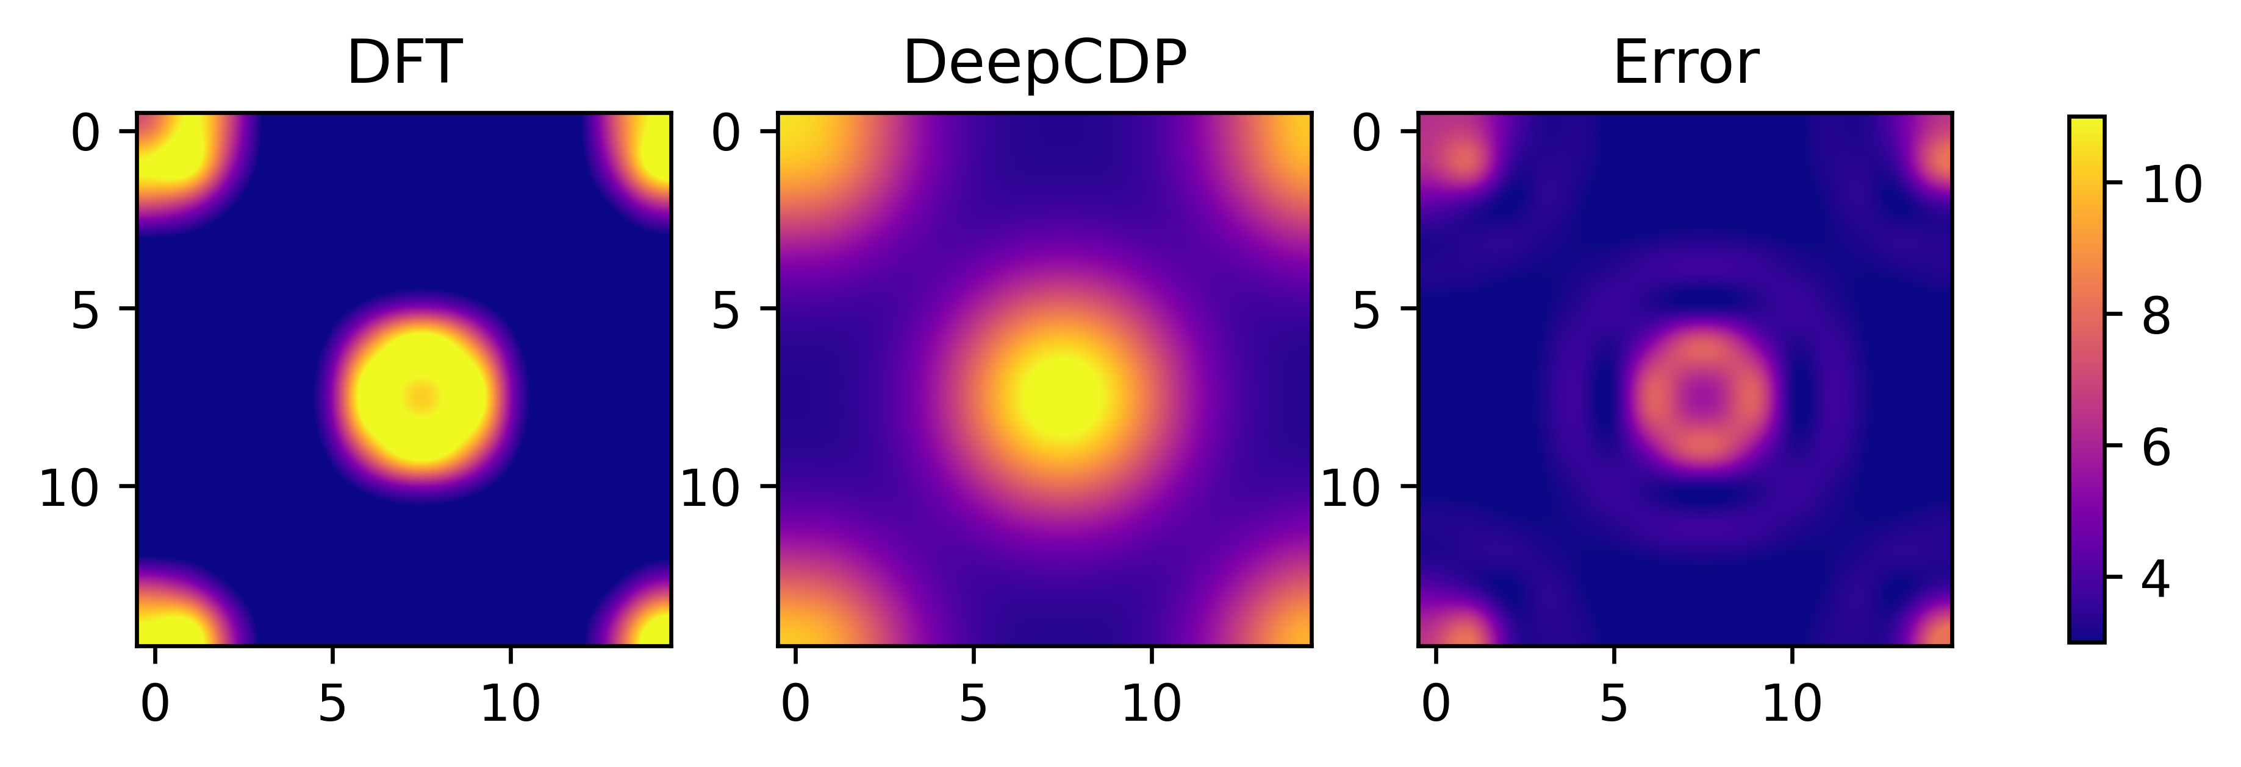
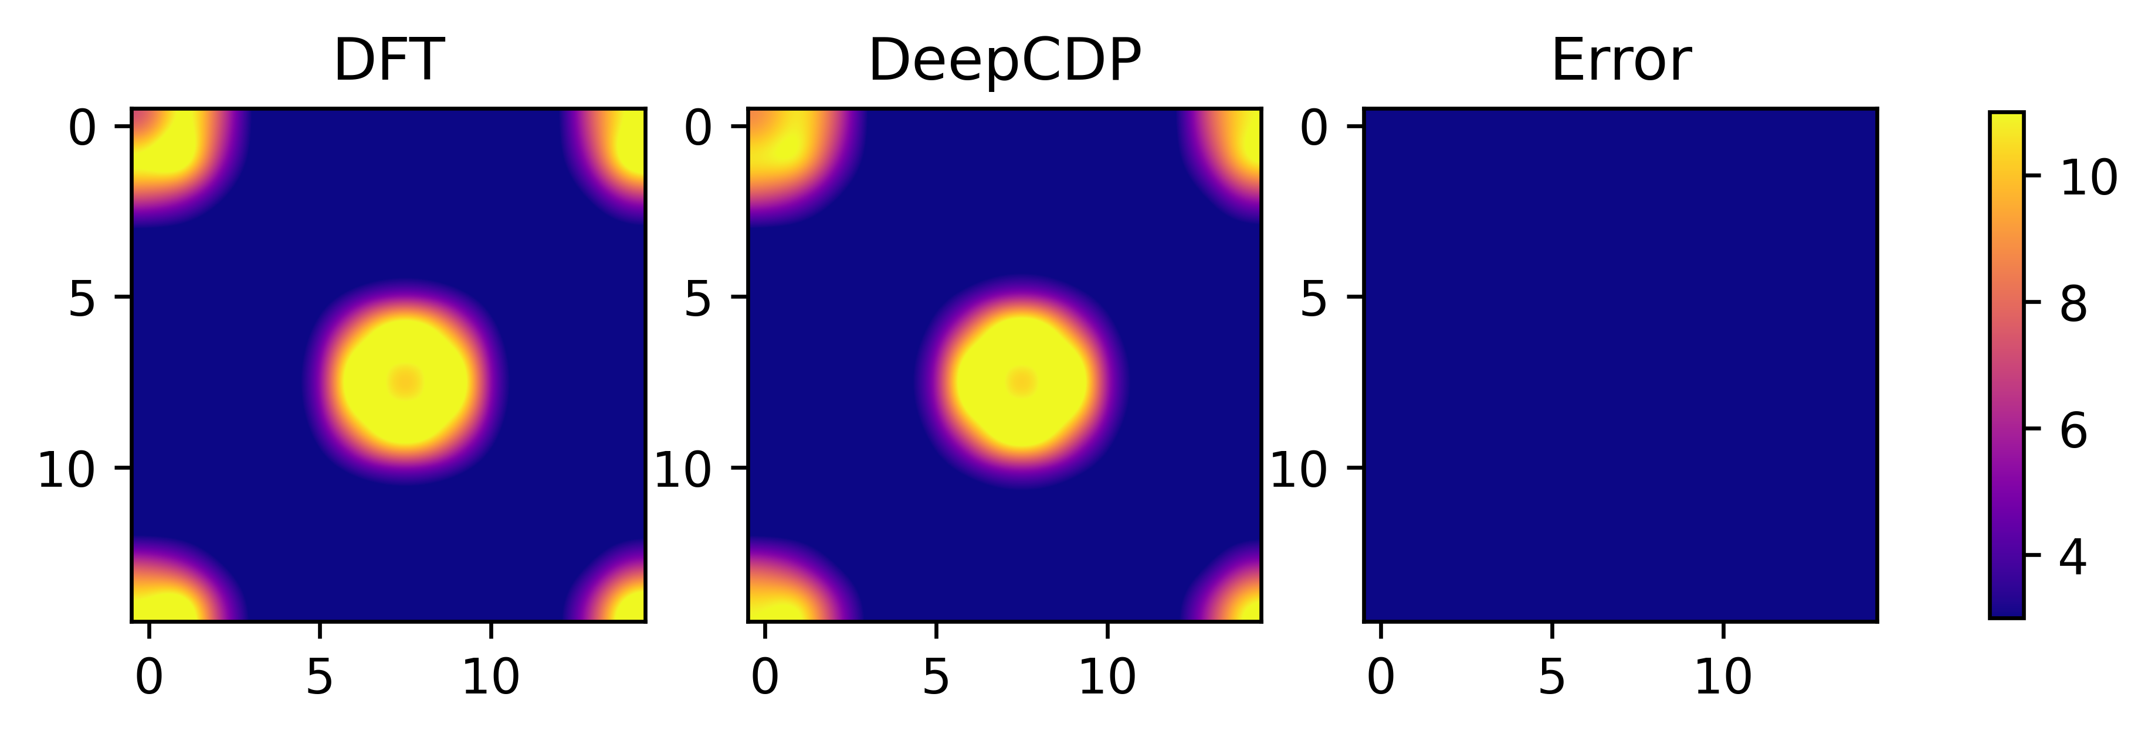
(a)
(b)

Slide 2
(a)
(b)
(c)

Slide 3
(a)
(b)

Slide 5
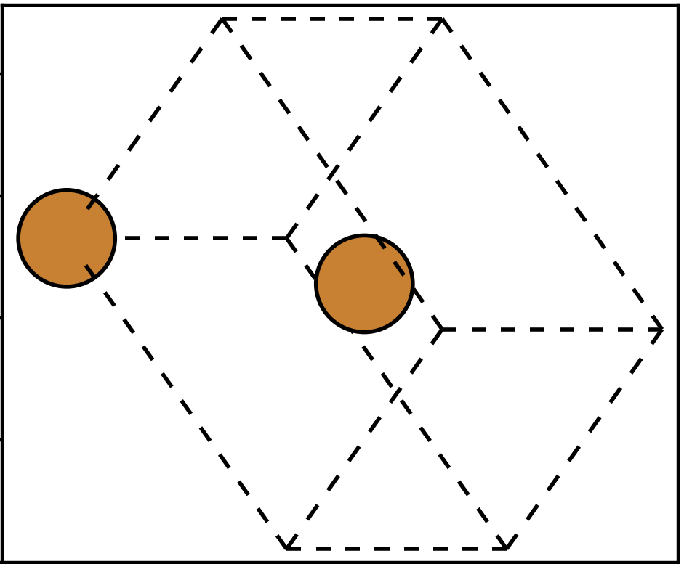
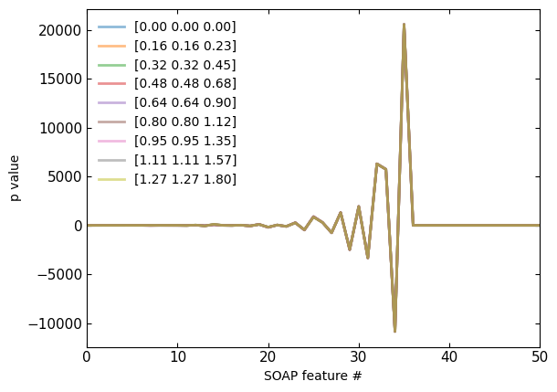
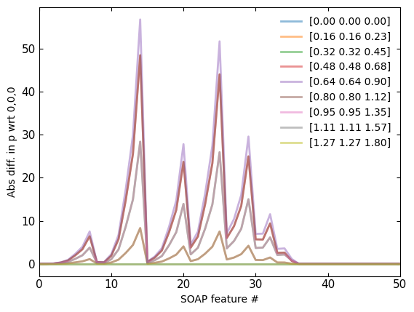
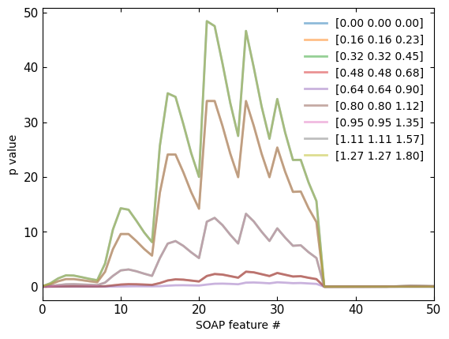
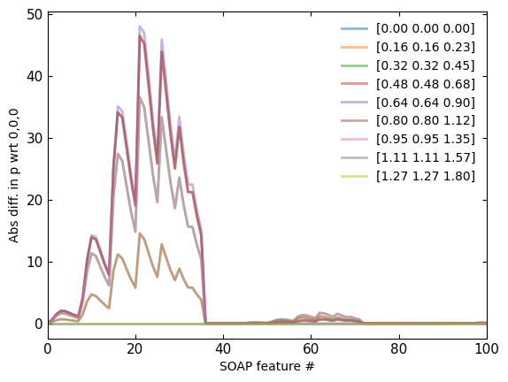
Non-weighted
Non-weighted
(b)
(c)
Weighted
Weighted
(d)
(e)
(a)

Slide 6
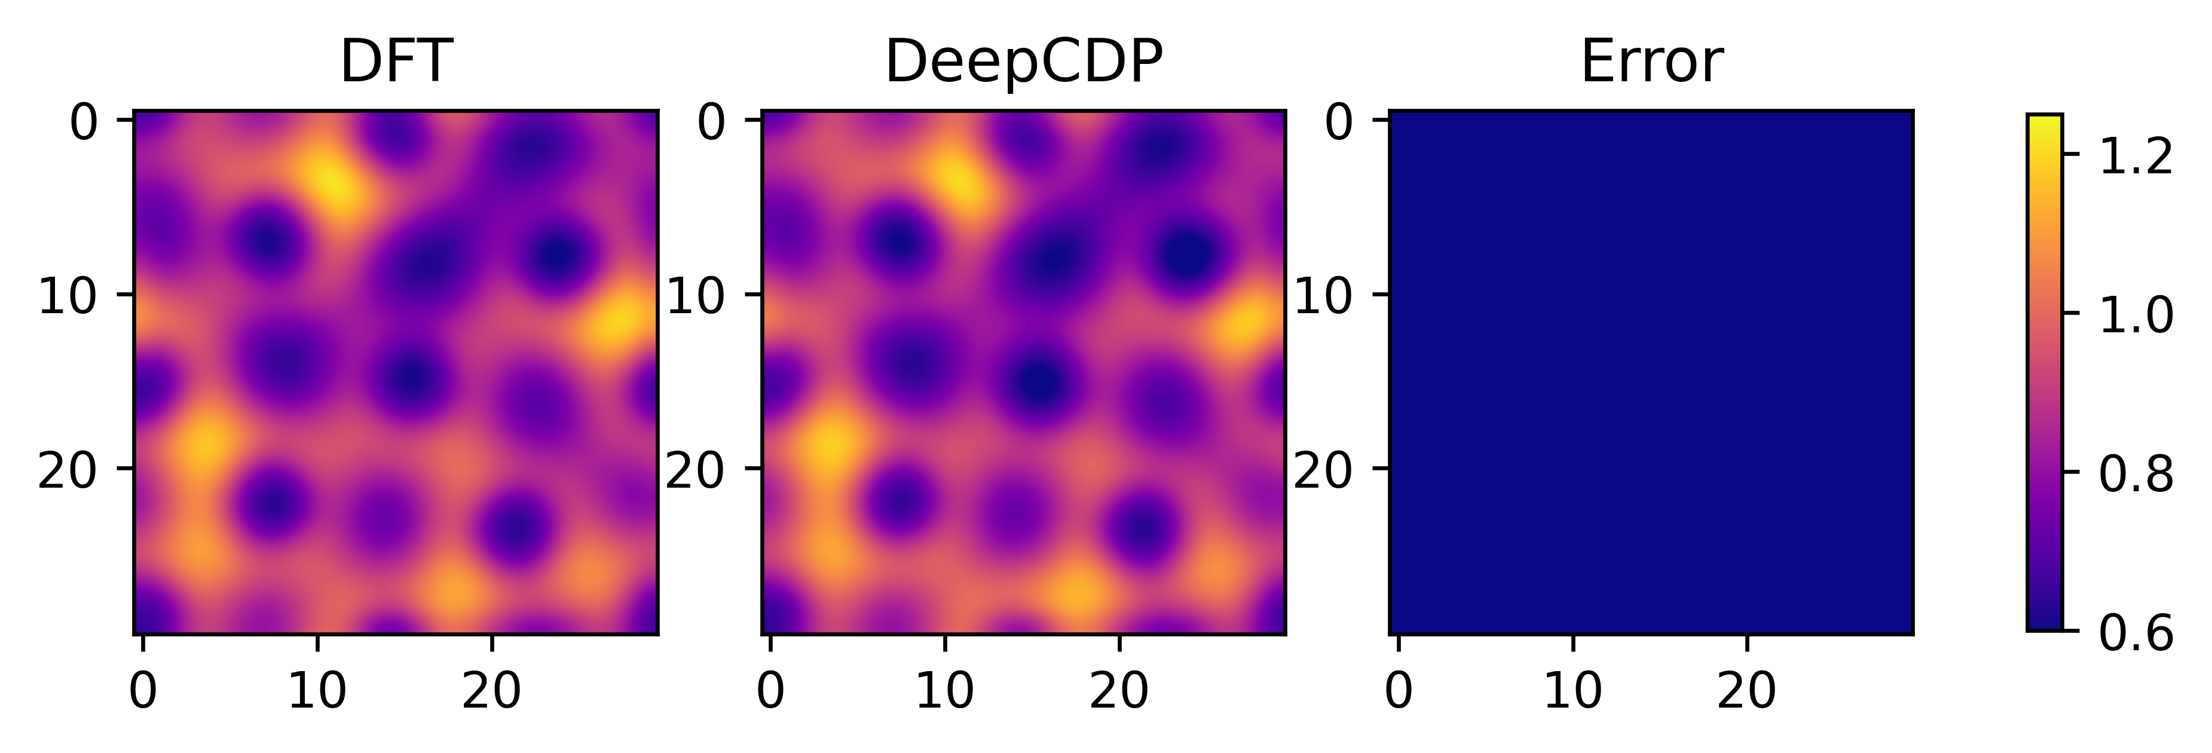
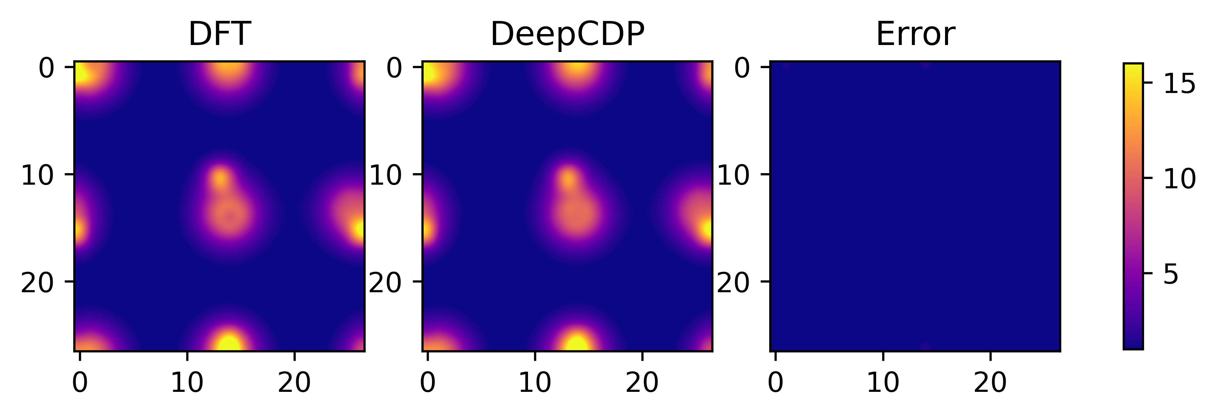
(a)
(b)

Slide 7
(d)
(e)

Slide 8
(a)
(b)
(c)

Slide 9
(a)
(b)
(c)

Slide 10
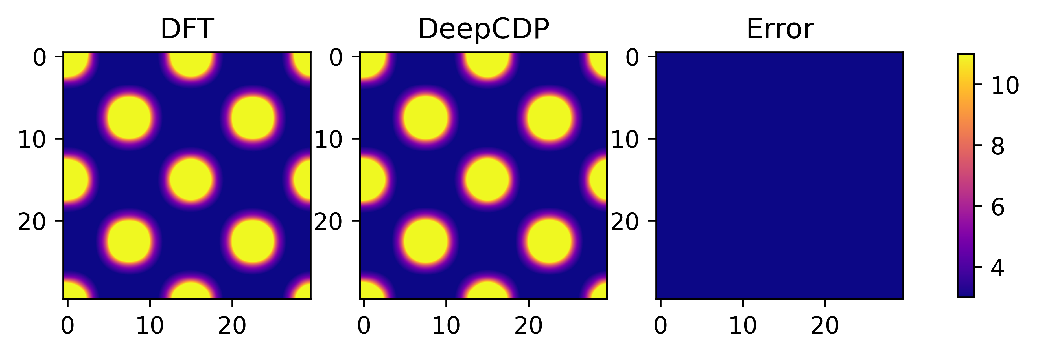
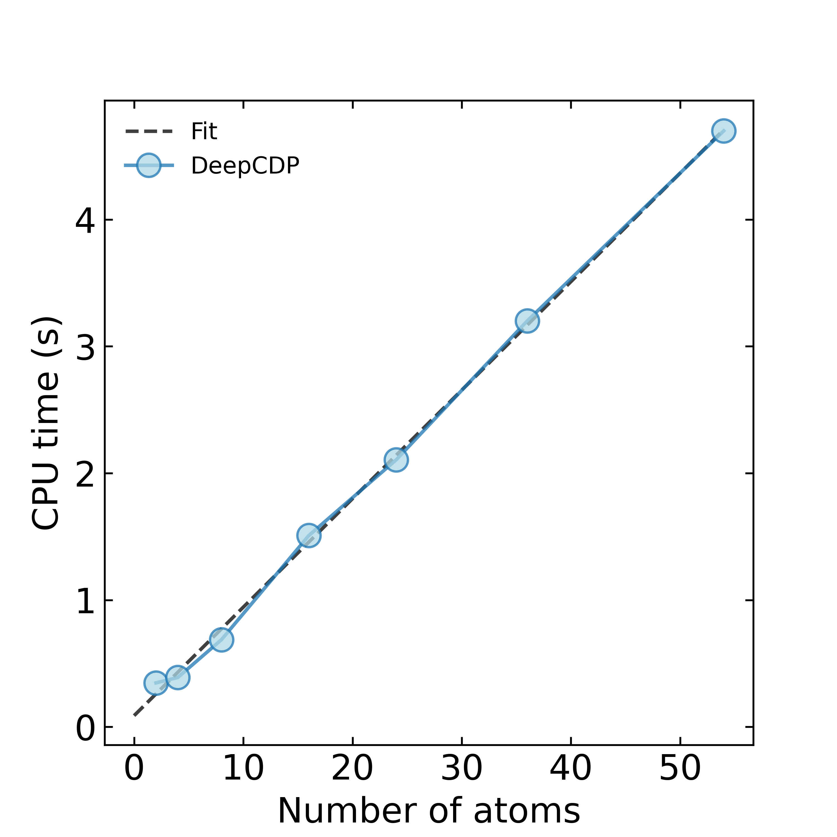
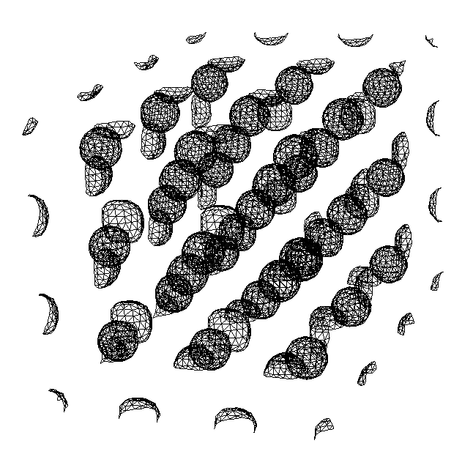
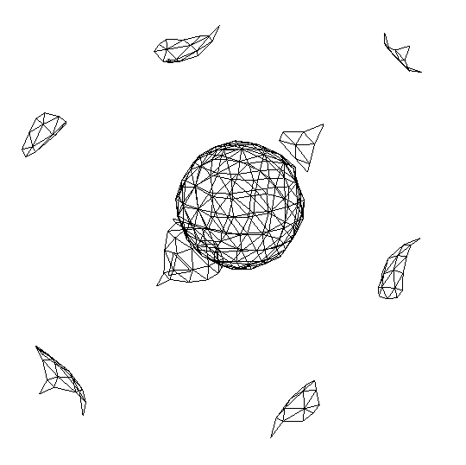
(a)
(b)
N = 54
N = 2
(N)

Slide 11
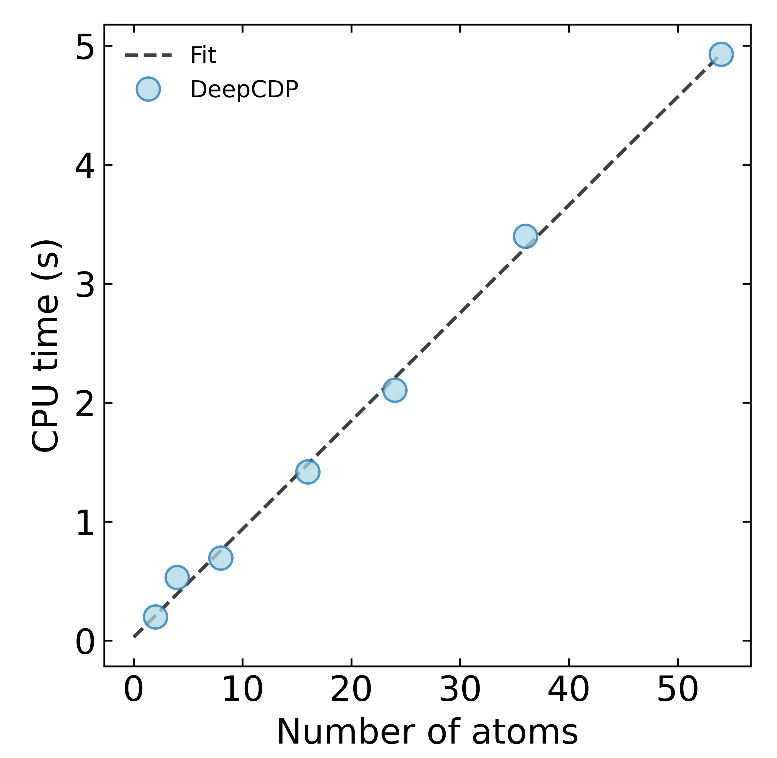
(a)
(b)
N = 54
N = 2
(N)

Slide 12
(a)
(b)
N = 54
N = 2
(N)

Slide 13
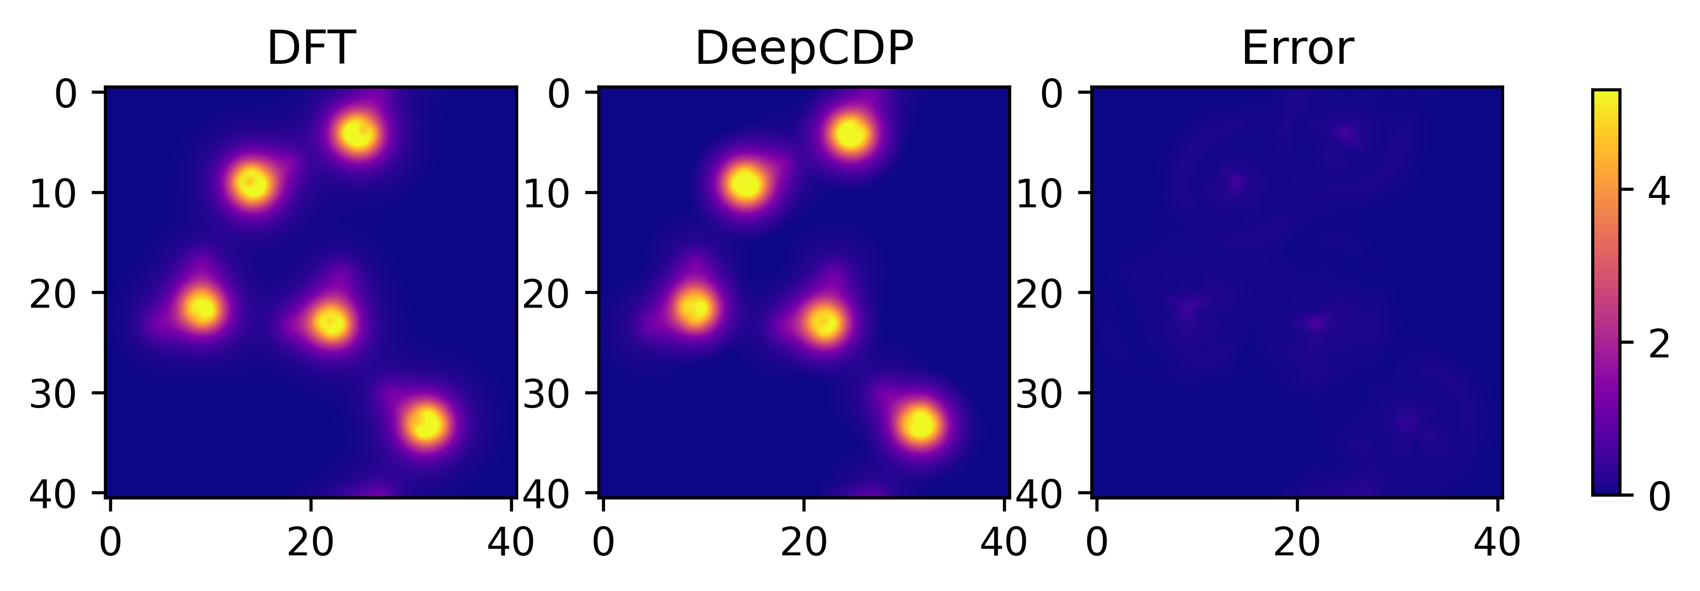
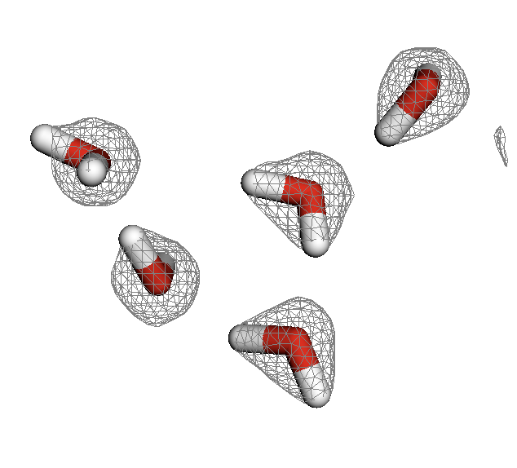
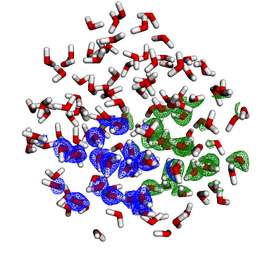
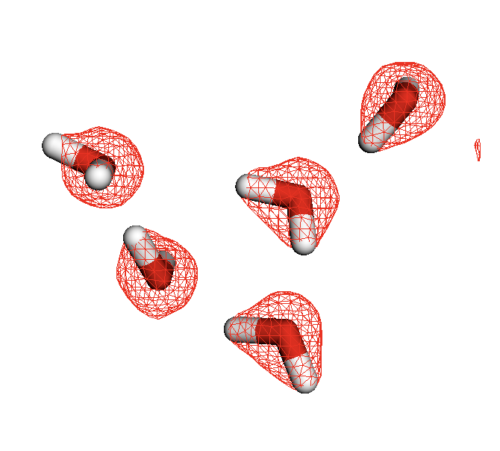
(a)
(b)
DFT
(c)
DeepCDP

Slide 14
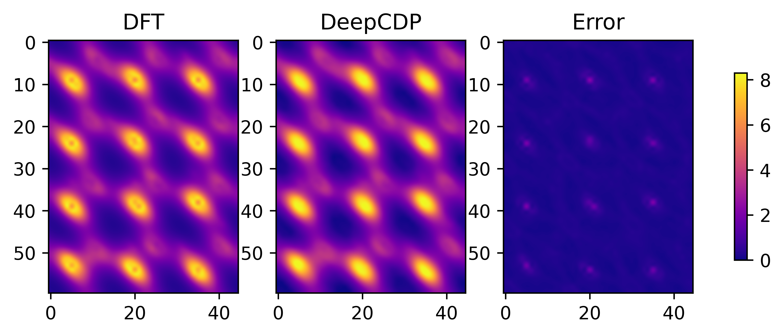
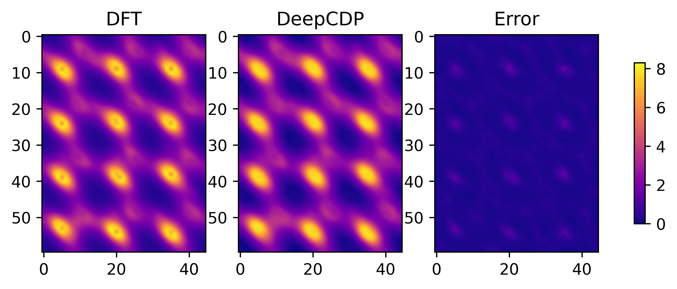
(a)
(b)
DeepCDP (u24C)
(c)
DeepCDP (c24C)

Slide 15
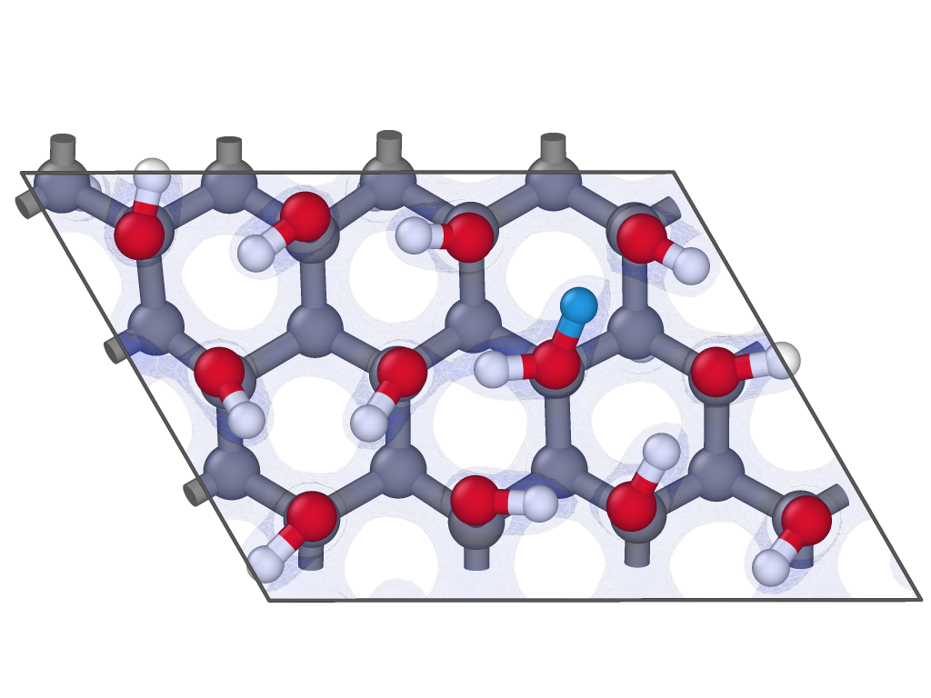
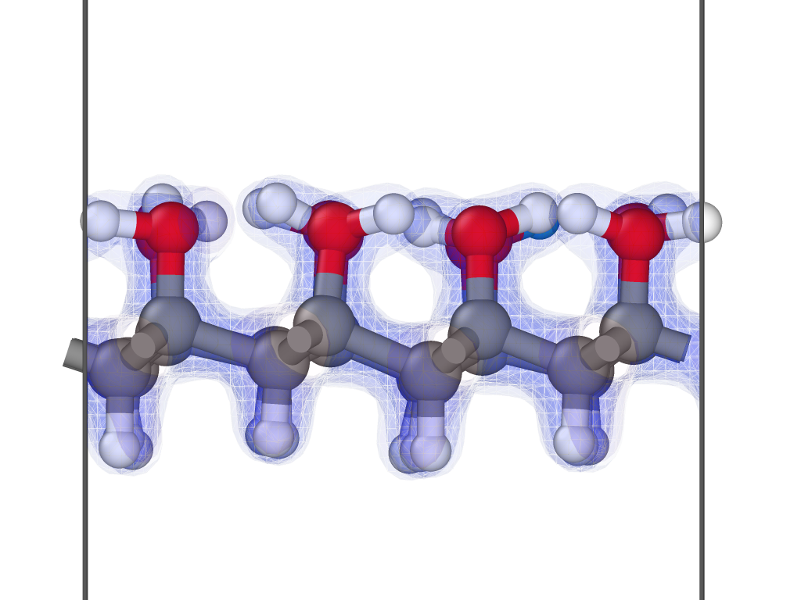
(a)
(b)
DeepCDP (u24C)
(c)
DeepCDP (c24C)

Slide 16
(a)
(b)
DFT
DeepCDP (u24C)
Error
(c)
DFT
DeepCDP (c24C)
Error

Slide 18
(a)
(b)
DeepCDP (u24C)
(c)
DeepCDP (c24C)

Slide 19
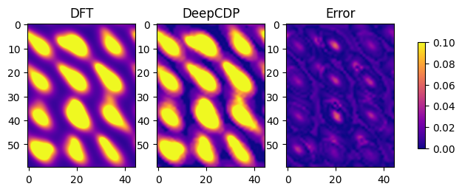


Slide 20
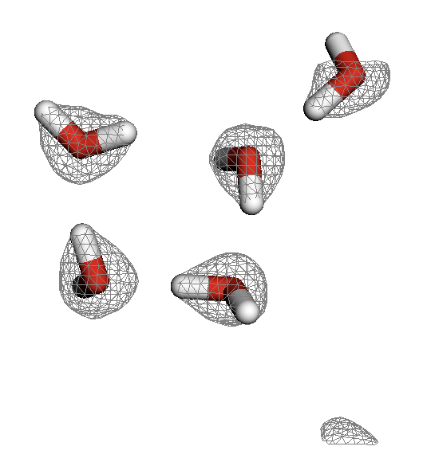
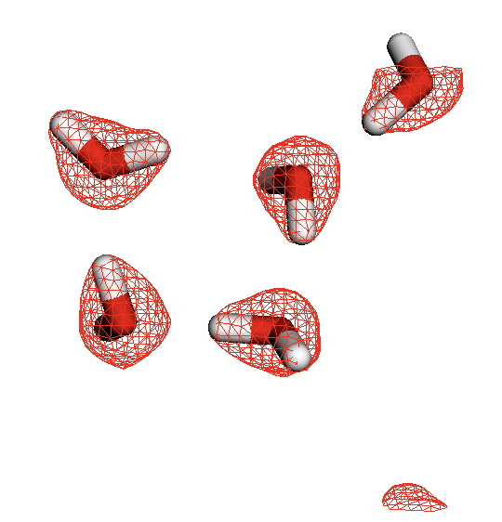

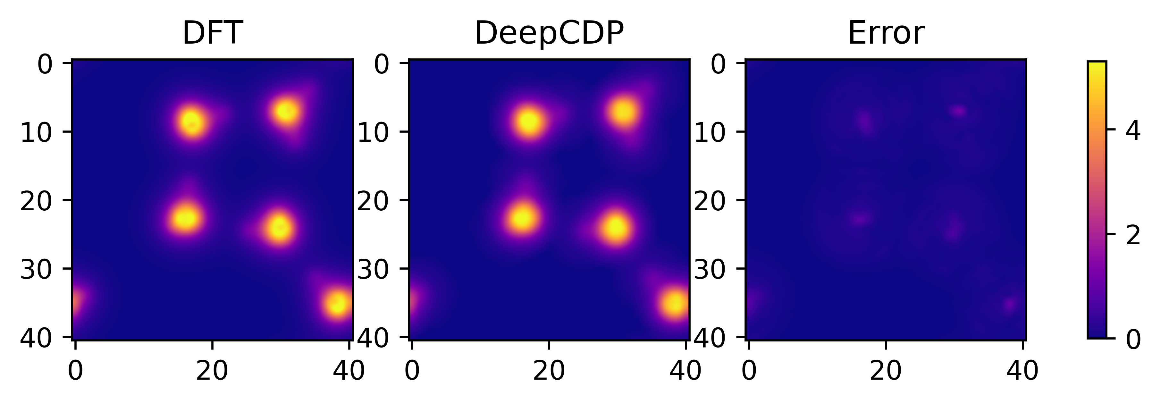
(a)
DFT
DeepCDP (c24C)
Error
(b)
DeepCDP (c24C)

Slide 21
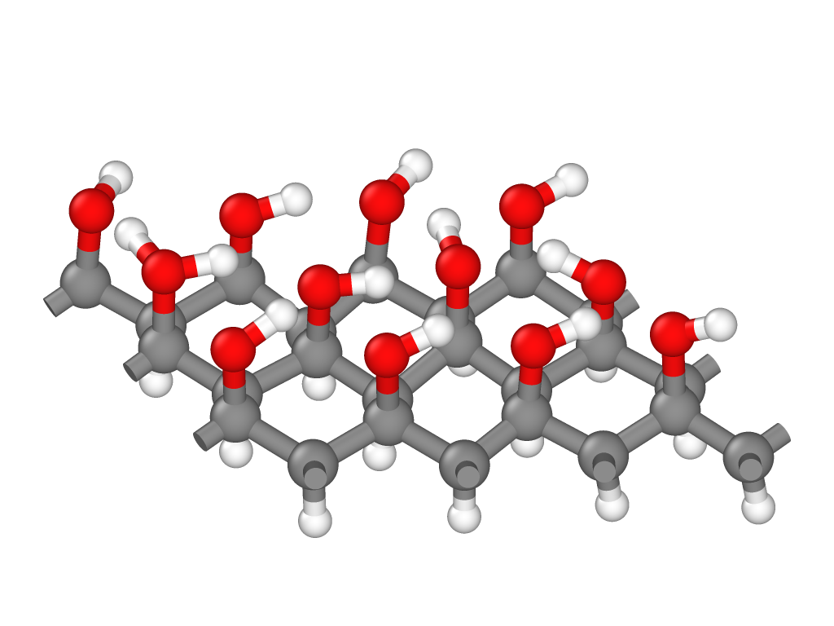





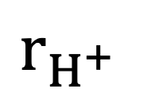








$$r_{H^{+}}$$
$$κ_{1}$$
$$κ_{3}$$
$$κ_{4}$$
$$κ_{2}$$
$$κ_{5}$$
$$κ_{8}$$
$$κ_{6}$$
$$κ_{9}$$
$$κ_{7}$$
$$κ_{10}$$
$$κ_{11}$$
$$κ_{12}$$
$$κ_{13}$$

Slide 22
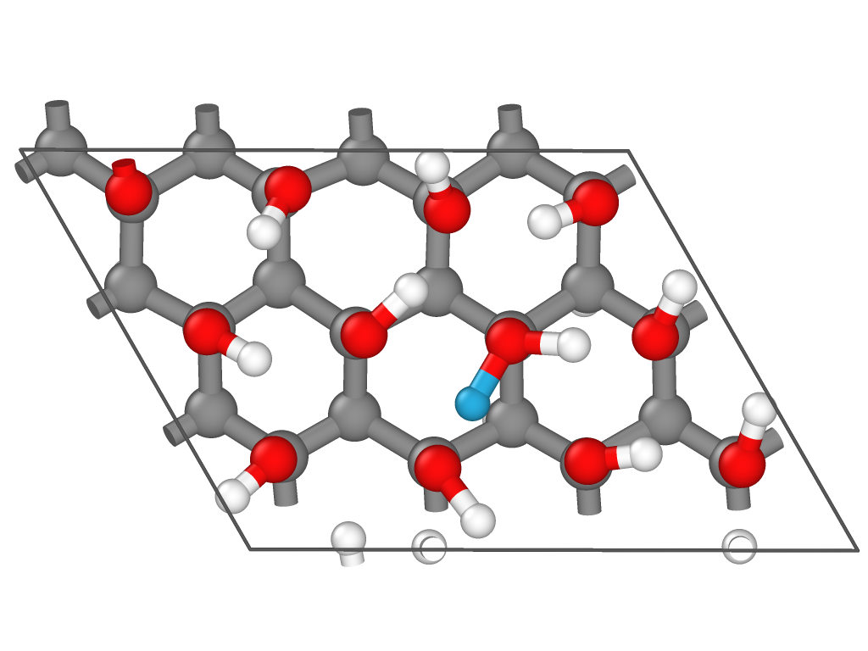
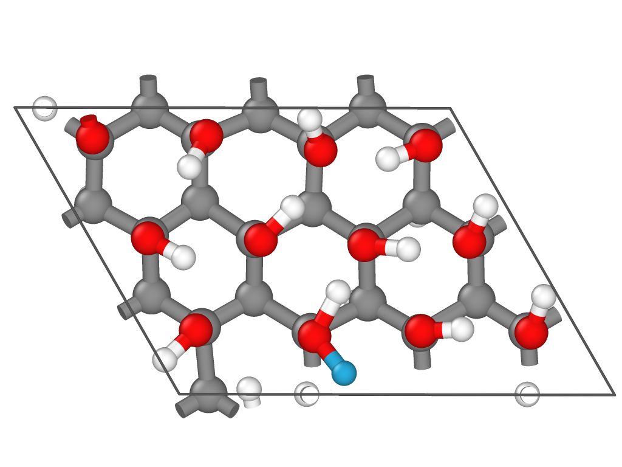
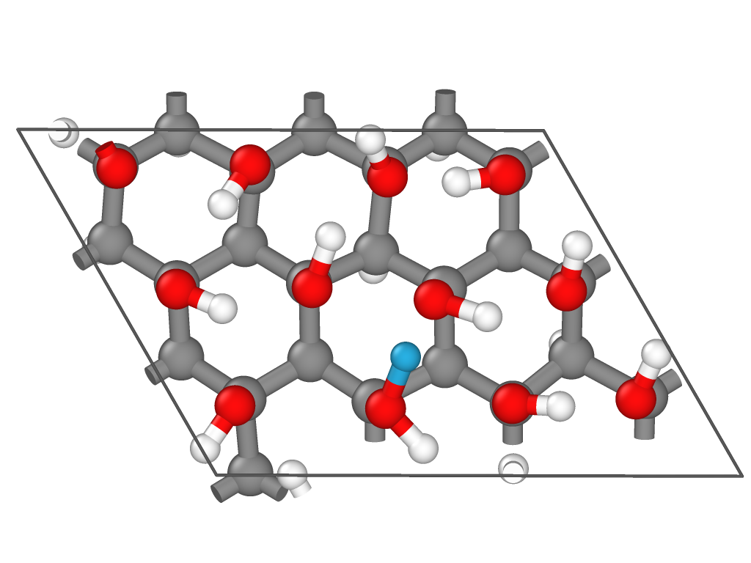
1
1
1
2
2
2
(a)
(b)
(c)

Slide 23
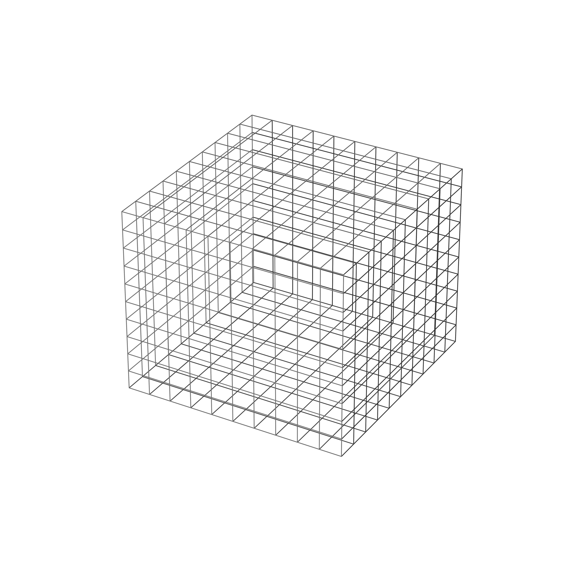
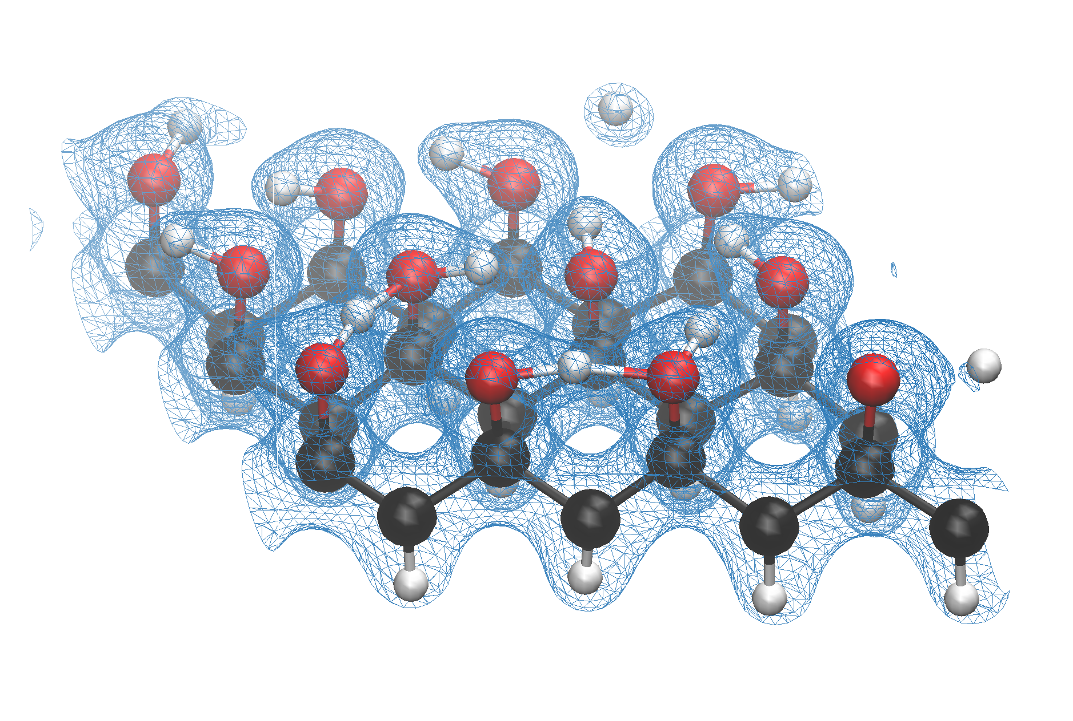

Slide 24
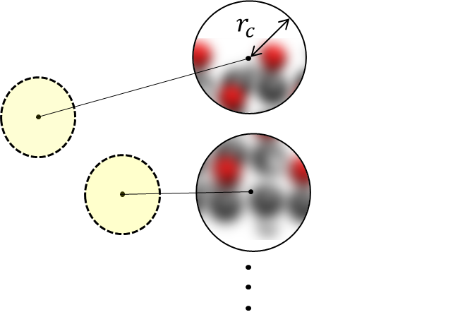
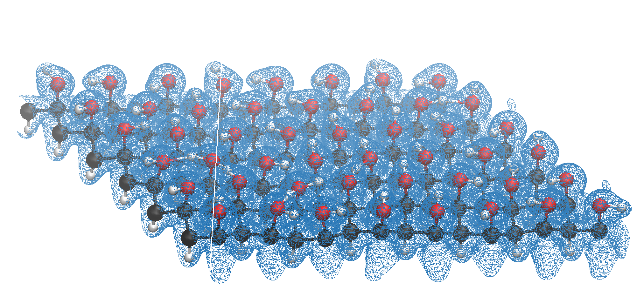
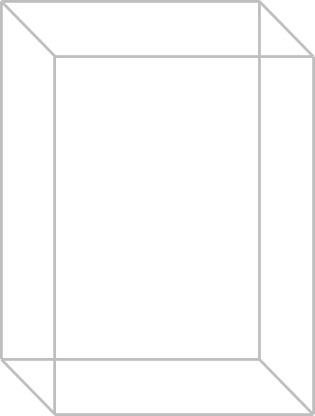
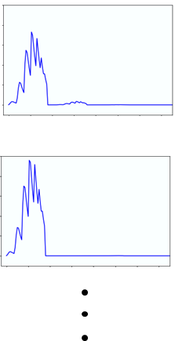
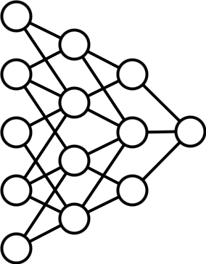
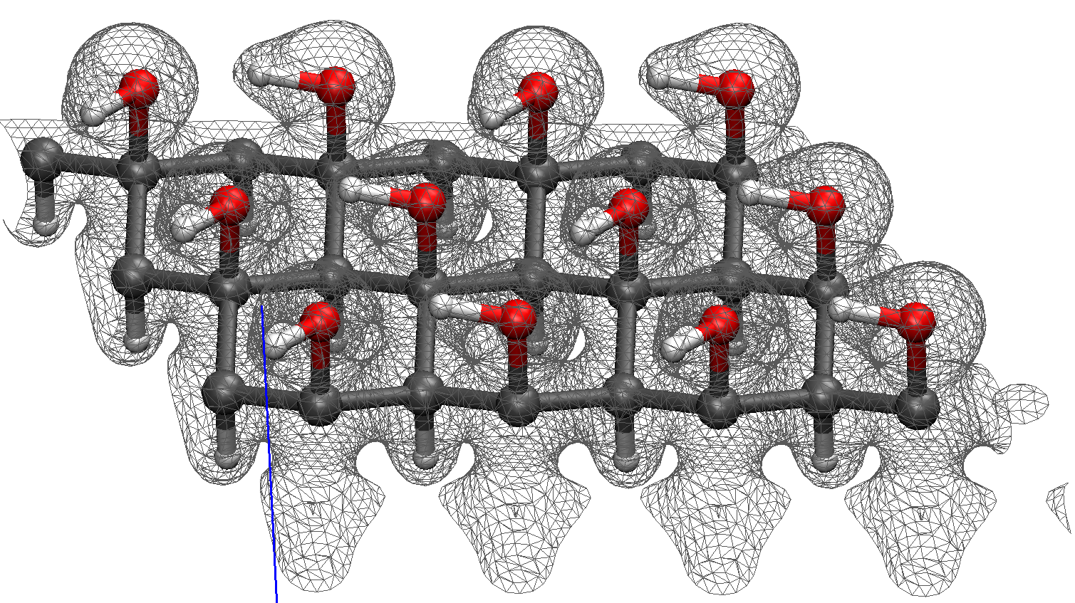
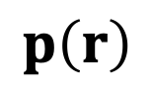
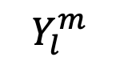
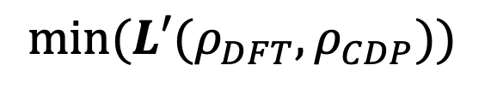
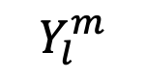
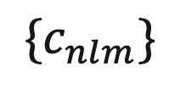
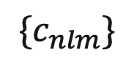
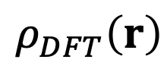
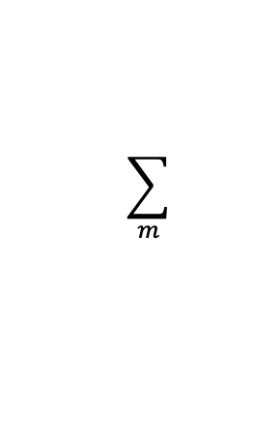
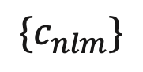
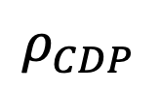
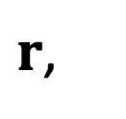


$$Y_{l}^{m}$$
$$\sum_{m}{ }$$
$${\{c}_{nlm}\}$$
$$Y_{l}^{m}$$
$$\sum_{m}{ }$$
$${\{c}_{nlm}\}$$
$r$,
$$ρ_{DFT}\left(r\right)$$
$$ρ^{Z}(r)$$
$${\{c}_{nlm}\}$$
$$p\left(r\right)$$
$$min(L′(ρ_{DFT},ρ_{CDP}))$$
$$ρ_{CDP}$$
Atomic coordinates and electron density from DFT
Expansion coefficients from atomic densities and spherical harmonics
Power spectrum vectors
Fitting neural network by minimizing loss function
Electron density prediction on test configurations

Slide 25


(a)
(b)

Slide 26
(a)
(b)
DFT
DeepCDP
Error

Slide 27
(a)
(b)
DFT
DeepCDP
Error

Slide 28

7.5
10.0
12.5

